Slide 1

Capstone Project
AI- Based human drowning detection in swimming pools using YOLO V6 with deep learning.
Team no: 7
MLA0403 – Deep Learning
Guided By
Dr.A.M.Arul Raj
Professor
SIMATS Engineering
Students Name
P.Akhila (192425225)
C. Hymavathi(192425397)
B.Sahithi(192525216)
Ajitha.M (192525391)
Notes:
1
1

Slide 2


Abstract
AI-Based Human Drowning Detection in Swimming Pools Using YOLOv6 with Deep Learning is a smart surveillance system for improving swimmer safety.
The system uses YOLOv6 to detect swimmers and identify possible drowning incidents in real time.
CCTV camera footage is analysed to recognize abnormal movements and drowning behaviour.
An automatic alert is generated to notify lifeguards immediately.
The proposed system reduces manual monitoring and enables faster emergency response.
It provides an accurate, efficient, and cost-effective solution for drowning detection in swimming pools.

Slide 3
Aim and Objective
Main Aim
To develop an AI-based real-time drowning detection system using YOLOv6 and deep learning that continuously monitors swimming pools, detects potential drowning incidents accurately, and provides immediate alerts to enable timely rescue and improve swimmer safety.
Objectives
Develop a real-time drowning detection system using YOLOv6.
Detect and track swimmers from CCTV video footage.
Identify drowning behaviour based on body posture and movement patterns.
Generate instant alerts to lifeguards when a drowning incident is detected.
Improve detection accuracy while reducing false alarms.
Enhance swimmer safety through fast and automated emergency response.

Slide 4
Introduction
Drowning is a major cause of accidental deaths in swimming pools and requires quick detection.
Manual monitoring by lifeguards may not always identify emergencies on time.
This project uses AI and Deep Learning to detect drowning incidents in real time.
YOLOv6 detects swimmers and analyses their movements to identify possible drowning behaviour.
The system generates instant alerts, helping lifeguards respond quickly and improve swimmer safety.

Slide 5
Literature Review
S.No | Year of Publication | Author(s) | Title of the Journal / Book | Methodology Used | Algorithm Used | Key Findings
1 | 2026 | Zhang et al. | IEEE Access – AI-Based Real-Time Drowning Detection in Swimming Pools | Real-time CCTV video analysis using deep learning | YOLOv8 | Achieved high detection accuracy with reduced false alarms and fast response time.
2 | 2025 | Kim et al. | Expert Systems with Applications – Vision-Based Drowning Detection Using Deep Learning | Human posture and motion analysis from surveillance videos | YOLOv7 + CNN | Improved drowning detection performance under different swimming conditions.
3 | 2024 | Li et al. | Pattern Recognition Letters | Object detection and abnormal activity recognition | YOLOv5 | Enhanced detection speed and accuracy for water-surveillance applications.
4 | 2023 | Wang et al. | IEEE Transactions on Intelligent Transportation Systems | Deep learning-based video monitoring | Faster R-CNN | Produced reliable human detection but with slower processing than YOLO models.
5 | 2022 | Chen et al. | Sensors | Human activity recognition using surveillance videos | CNN | Improved classification accuracy but struggled with complex backgrounds.

Slide 6
Problem Statement
Statement 1: Existing drowning detection systems using conventional computer vision and earlier deep learning models often experience lower accuracy, higher false alarm rates, and slower real-time performance in swimming pool environments.
Statement 2: Therefore, there is a need for an AI-based real-time drowning detection system using YOLOv6 and deep learning to improve detection accuracy, reduce false alarms, and provide instant alerts for timely rescue.

Slide 7
Existing System
Swimming pools mainly rely on lifeguards for continuous monitoring and rescue.
Some systems use wearable sensors or basic CCTV surveillance to detect emergencies.
Traditional computer vision methods and earlier deep learning models (e.g., Haar Cascade, SVM, Faster R-CNN, CNN) have also been used for drowning detection.
These systems often suffer from delayed detection, false alarms, limited accuracy, and reduced performance in crowded or complex swimming pool environments.

Slide 8
Proposed System
Develop an AI-based drowning detection system using YOLOv6 and Deep Learning for real-time monitoring.
Capture and analyse live CCTV video to detect swimmers and identify drowning behaviour.
Continuously track body posture and movement patterns to improve detection accuracy.
Generate instant alerts to lifeguards when a drowning incident is detected.
Enable faster rescue response, improving swimmer safety and reducing the risk of fatalities.

Slide 9
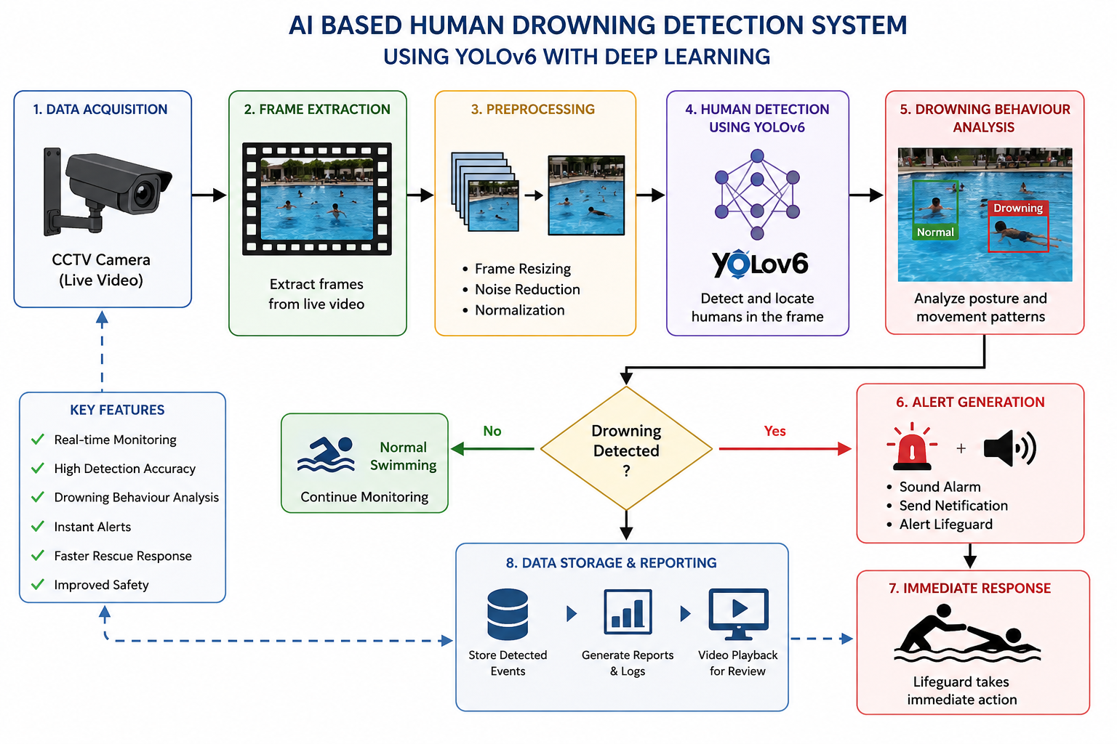
Architecture Design

Slide 10


Design & Module Planning
Module 1: Video Data Acquisition and Preprocessing
Module 2: Human Detection Using YOLOv6
Module 3: Drowning Behaviour Analysis
Module 4: Alert Generation and Emergency Response

Slide 11
Conclusion
The proposed system uses YOLOv6 and Deep Learning to detect drowning incidents in real time.
It continuously monitors swimmers through CCTV cameras and identifies potential drowning behaviour with high accuracy.
Instant alerts enable lifeguards to respond quickly, reducing rescue time.
The system minimizes dependence on manual monitoring and helps reduce false alarms.
Overall, the proposed solution enhances swimmer safety by providing an efficient, reliable, and automated drowning detection system.

Slide 12
References
Oh, S. H., Park, S. W., & Kim, J. G. "AI-Based Drowning Detection in UAV-Assisted Coastal Environment." International Conference on Information Networking (ICOIN), IEEE, 2025.
Elhanashi, A., Saponara, S., Dini, P., et al. "Intelligent Video Surveillance for Early Drowning Detection Using Deep Learning." SPIE Real-Time Processing of Image, Depth and Video Information, 2025.
Ghute, M., Katole, T., Hadge, A., Walke, A., & Gabhane, G. "Design of Drowning Rescue Alert System." 2024 8th International Conference on Inventive Systems and Control (ICISC), IEEE, 2024.
Gao, Q., Pan, J., Zhang, X., & Chen, X. "Design of Drowning Detection Method Based on YOLOv8." 2024 IEEE 6th International Conference on Civil Aviation Safety and Information Technology (ICCASIT), IEEE, 2024.

Slide 13
Thank you

